Slide 1

Project No. : P142
Group No : 03
Date:- 31st Oct 2022
A
PROJECT PRESENTATION
ON
RESUME CLASSIFICATION

Slide 2
Group Members
Contribution in Project Work
Anjali Kale
Gauri Agharkar
Hrutuja Mohangekar
Monika Sonawane
Yashraj Dalwe
Chaitali Ingale
Shubham Dhavan
Trupti Kendre
Mentor:- Mr. Adavaith
Anjali : Resumes Segregation → Created Folders & Uploaded resumes
Gauri : Created connection between Google Collab with Drive
Hrutuja : Complied all resumes in Google Collab
Monika : Prepared Final Data by Concat of all categories
Yashraj : Performed Data Analysis & Pre-processing
Chaitali : Shown word cloud of Resumes & labelled Category
Shubham : Shown Bar Chart & Pie Chart and Word cloud for categories
Trupti : Implementation of different classification models

Slide 3
Business Objective :
The document classification solution should significantly reduce the manual human effort in the HRM. It should achieve a higher level of accuracy and automation with minimal human intervention.
Introduction :
Resume Classification/Screening ( NLP & Machine Learning)→ Choosing the right people for the job is the biggest responsibility of every business since choosing the right set of people can accelerate business growth exponentially. We have imported few libraries for resume classification/screening and they are namely as : Pandas, NumPy, Matplotlib, Word cloud & different classifier to fetch resumes information & to plot corresponding visualization.

Slide 4



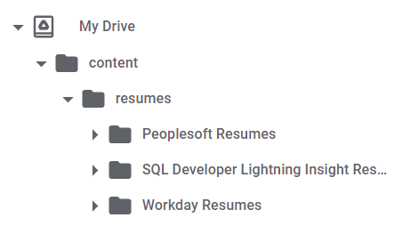
Dataset Source :
We have resumes in different extensions (.doc,.docx,.pdf) and all those are imported on Google Drive and later they are inter-connected with Google Collab.
Connection between Google Collab and Drive
Path
Show the list resumes which we have uploaded on MyDrive

Slide 5
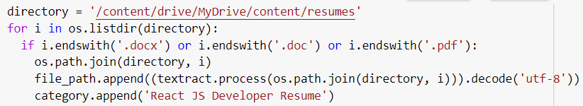

Appending all Resumes in a Drive
Appending "React JS Developer Resumes" in a Drive
Similarly ,we have appended remaining unique category resumes i.e.
PeopleSoft Resumes
SQL Developer Lightning Insight Resumes
Workday Resumes
Later all the categories are Concat in a single Column → ‘Category’ and stored in a data variable.

Slide 6
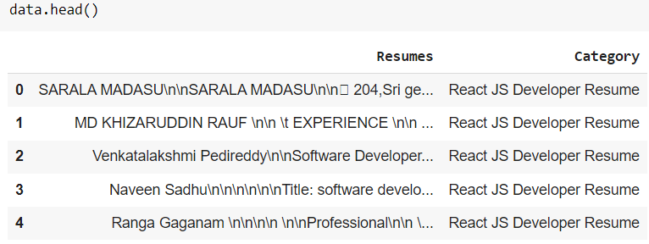
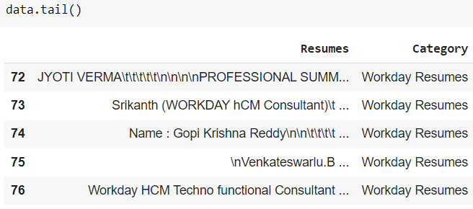
Look of Dataset
Data Exploration :
Data Preprocessing :
Check the null values by data.isnull().any()
Synthesis data
Remove punctuation marks
URL
non-english characters
hashtags
extra-white spaces
Tokenize word
Remove Stopwords
Data Analysis :
Check data.info()
data.describe()
Tokenization is the process of breaking text up into smaller chunks as per our requirements

Slide 7
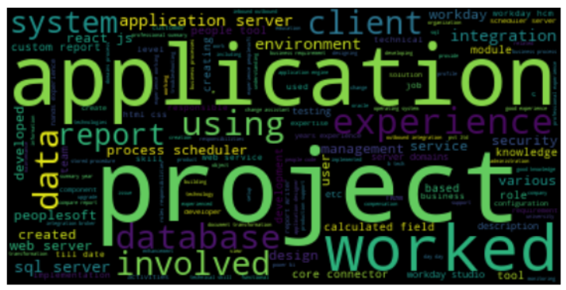
Lemmatization refers to the use of vocabulary & morphological analysis of words ,aiming to return the base or dictionary form of the word --> known as 'lemma'
Wordcloud of Cleaned Sentences :
Lemmatized words

Slide 8
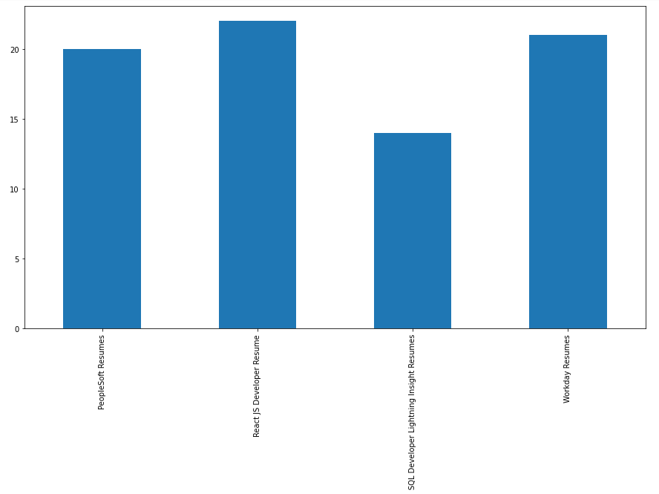
Bar Chart of “Category” Column
After labelling respective resumes with category ,will see below Bar Chart
data['Category'].value_counts().sort_index().plot(kind='bar', figsize=(15, 8))
plt.show()
Visualizing the chart

Slide 9
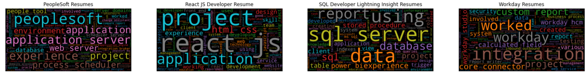
Wordcloud of Each “Category”
Based on the Preprocessed Data respective “Category “ wordclouds are shown below :
Visualizing the Wordcloud

Slide 10
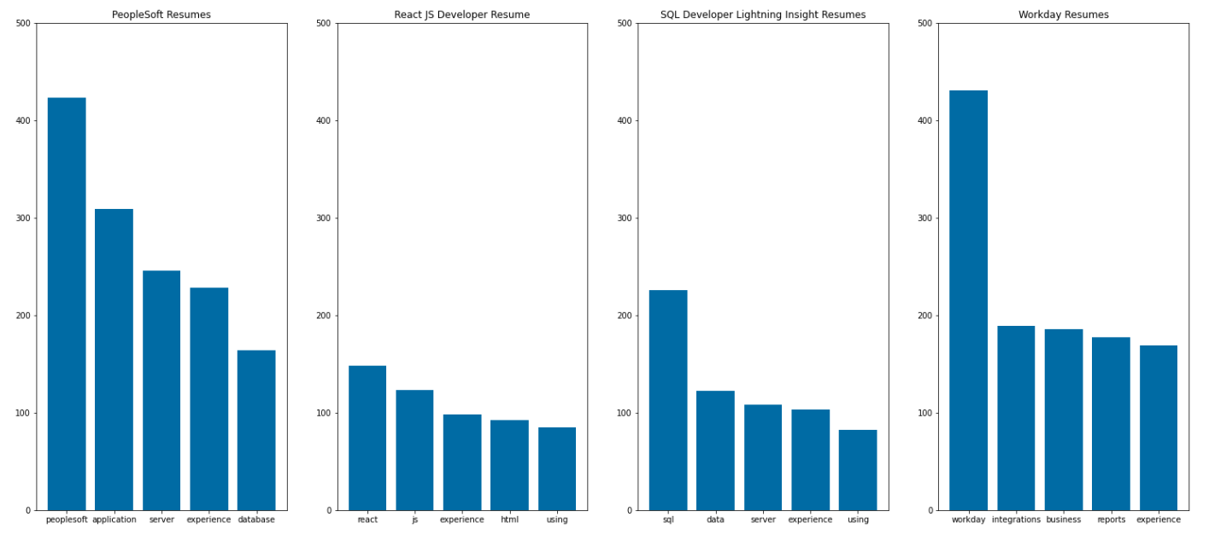

Word - Frequency from “Category” Column
Visualizing the Bar chart of
Word Frequency for each “Category”

Slide 11
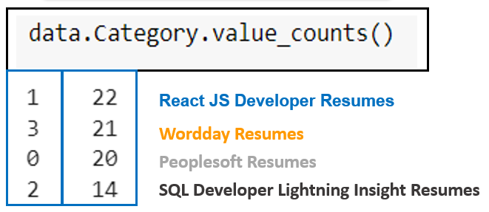
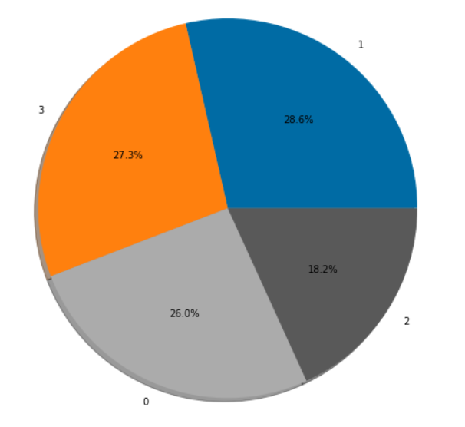
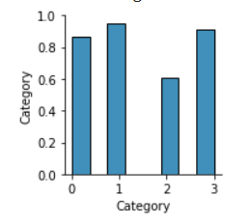
Label Encoder to Category Column
Pie Chart : “Category” Column
Pair Plot

Slide 12
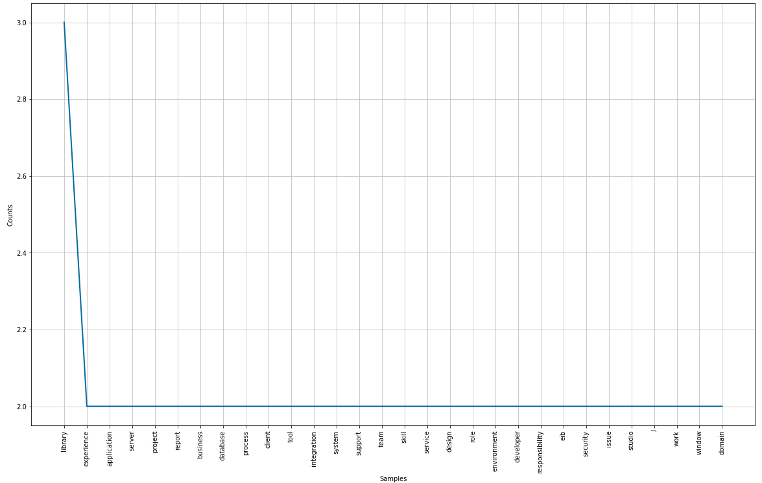
Frequency Distribution of “Lemma” Word

Slide 13
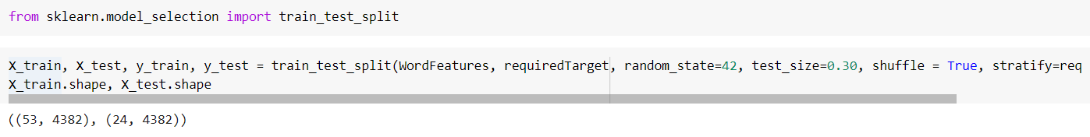
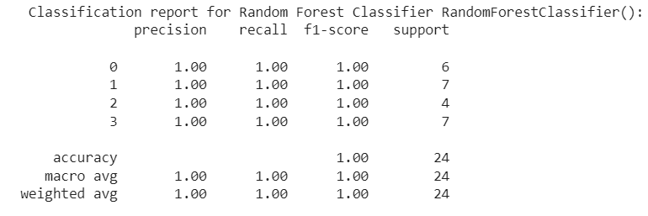
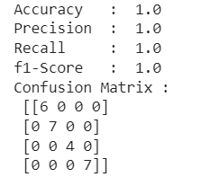
Splitting of Data into Train & Test
Train Data
Test Data
Implementation of Different Classification Models :
Random Forest Classifier

Slide 14
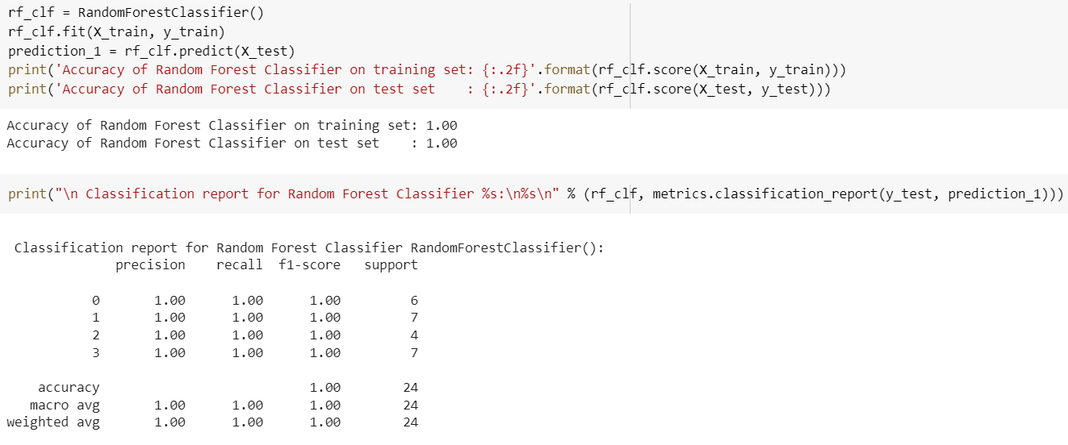
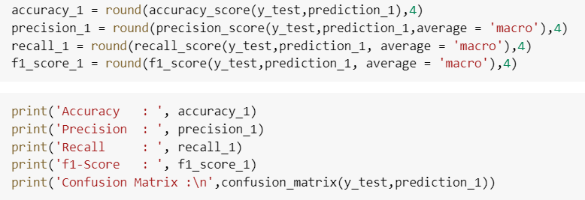
For Example: Random Forest Classifier Code

Slide 15
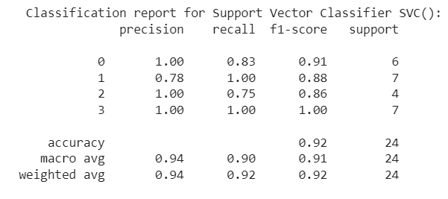
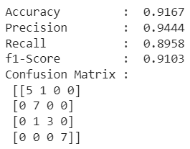
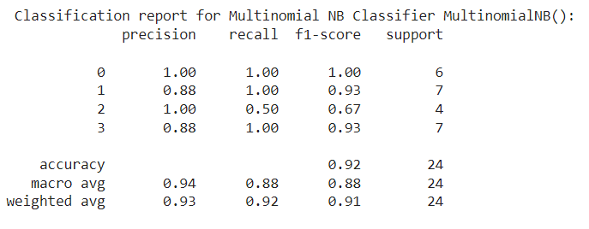
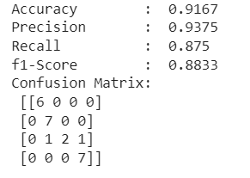
Support Vector Classifier :
Naive Bayes_ MultinomialNB :

Slide 16
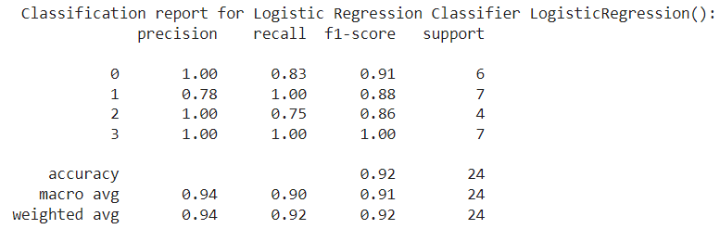
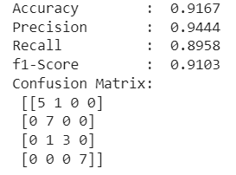
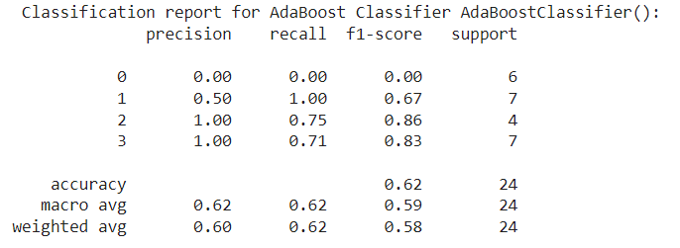
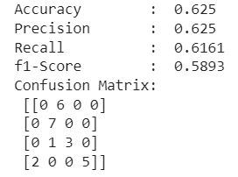
Logistic Regression Classifier :
AdaBoost Classifier :

Slide 17
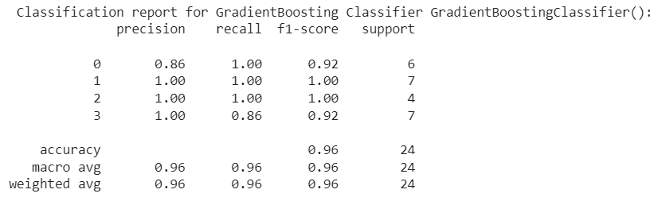
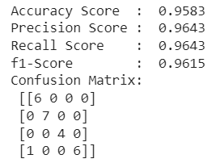
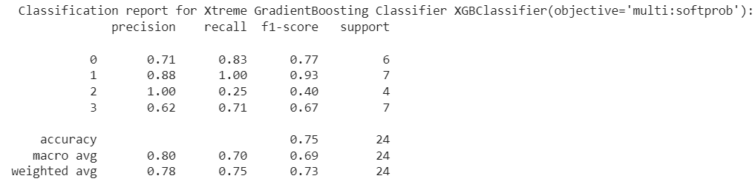
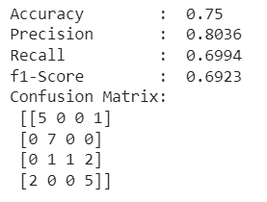
Gradient Boosting Classifier :
Xtreme Gradient Boosting Classifier :

Slide 18
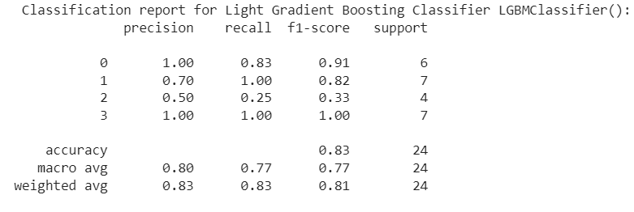
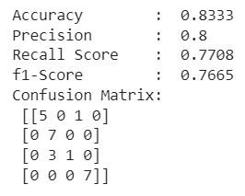
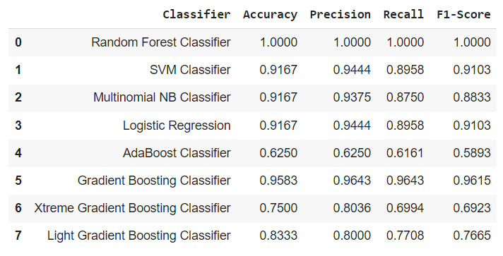
Light Gradient Boosting Classifier :
Final _Table :

Slide 19
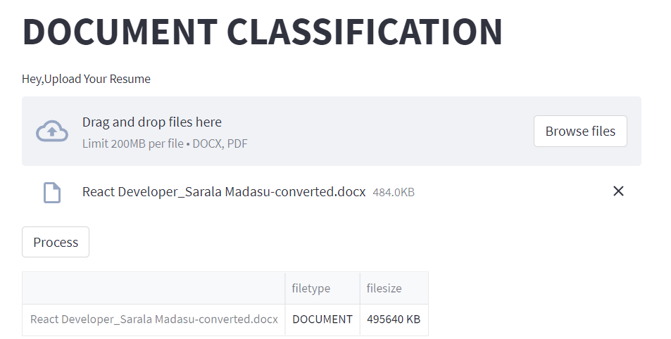
Model Deployment on Web Server :
For model deployment ,we have implemented data on streamlit.
1.Create .py file for deployment → Drag and drop file→ To see wordcloud and 20 Most freq. words
2.Open the command prompt
3.Run pip install streamlit
pip install pdfplumber
streamlit run filename.py
4.New window will open having deployment part
Just for Look

Slide 20
Conclusions :
From the final table we can conclude that among the calculated classifiers → Random Forest Classifier gave the favourable results i.e Precision & Recall is 1.0 and that too F1-score is also 1.0. which is harmonic mean of precision and recall.
Project GitHub Links of Group Members :
Anjali Kale : https://github.com/anjalikale503/NLP-n-classifires-project-
Gauri Agharkar : https://github.com/gauriagharkar/CLASSIFIRES-AND-NLP-PROJECT
Hrutuja Mohangekar : https://github.com/rutumohangekar/NLP-and-Classifier-models-project
Monika Sonawane : https://github.com/monika12344/resume-classification.git
5. Yashraj Dalwe : DalweYashraj/DS_Resume-Classification (github.com)
6. Chaitali Ingale : https://github.com/Chaitali1984/Resume-Classification-.git
Shubham Dhavan : https://github.com/ShubhamDhavan/Resume_Classification
Trupti Kendre : https://github.com/trupti2805/Resume-Classification.git

Slide 21
THANK YOU

